Slide 1

ISP550 INFORMATION SYSTEMS ENGINEERING
TOPIC 1: INTRODUCTION TO INFORMATION SYSTEMS ENGINEERING
March 2026 – August 2026

Slide 2
Learning Objectives
Define Information Systems Engineering
Describe the systems development life cycle (S D L C)
Describe the system development methodologies such as agile methodologies, eXtreme Programming, Scrum and RUP
Describe the roles of an information system engineer

Slide 3
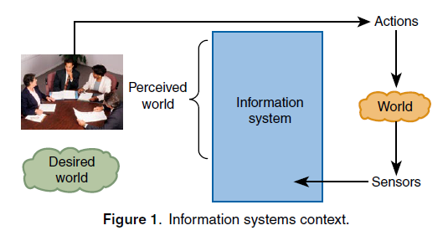
Definition
Definition : Information systems are computer-based infrastructures, organizations, personnel, and components that collect, process, store, transmit, display, disseminate, and act on information.
Information systems generally provide computer-based assistance to people engaging their environment as illustrated in Figure 1, where engagements and environments are often too complex and dynamic to be handled manually.

Slide 4
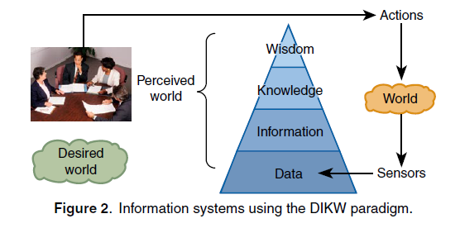
Definition
Complex, dynamic engagements and environments require people to analyze and draw conclusions from an abstracted representation of the world, which enables them to make discrete decisions to achieve a desired effect in the world commensurate with their roles, tasks and capabilities.
The abstraction is sometimes portrayed as a hierarchy (Figure 2) known as the Data, Information, Knowledge, and Wisdom (DIKW) paradigm.
Ackoff, R. L., “From Data to Wisdom,” J. Appl. Syst. Anal. 16, 3–9 (1989).
Cleveland, H., “Information as Resource,” The Futurist, 34–39 (Dec 1982).

Slide 5
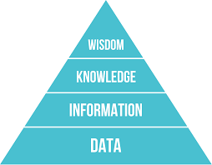
Definition
Data
are the smallest symbolic units that describe measured or estimated phenomena.
i.e.: sensors produce large volumes of data, but very little is understood by humans.
Information
information is a more abstract understanding of the data derived by fusing data
lowest layer where the symbolic units are interpretable by humans.
Knowledge
symbols are sufficiently abstract to enable people to make decisions about and interact with their environments.
combination of information with necessary data and judgment of historical patterns (experience).
Wisdom
is knowledge combined with insights and common sense.
It is typically achieved by humans based on knowledge, information, and data.
hard to derive automatically from lower-level information representations.

Slide 6
TERM INFORMATION SYSTEMS ENGINEERING
CONFERENCE ON ADVANCED INFORMATION SYSTEMS ENGINEERING (ISE COMMUNITY)
INTERNATIONAL COUNCIL ON SYSTEMS ENGINEERING (INCOSE)
Information systems engineering is situated at the intersection of information systems, databases and software engineering. The term was coined around 1990, possibly in connection with the start-up of the later so successful CAiSE (Conference on Advanced Information Systems Engineering) series of conferences.
It is notable that there are indeed three research communities corresponding to each of the above-mentioned fields, the ISworld, DBworld and SEworld communities.
Information Systems Engineering is an interdisciplinary approach and means to enable the realization of successful information systems.
ISE focuses on defining customer needs and required functionality early in the development cycle, documenting requirements, then proceeding with design synthesis, and system validation and deployment while considering the complete problem: - Operations & Maintenance, Performance, Cost & Schedule, Test, Realization, Training & Support, Disposal, Social aspects
Information Systems Engineering: What Is It? (Wangler and Backlund, 2005)

Slide 7
TERM INFORMATION SYSTEMS ENGINEERING
Information Systems Engineering integrates all the disciplines and specialty groups into a team effort forming a structured development process that proceeds from concept to production to operation.
Information Systems Engineering considers both the business and the technical needs of all customers with the goal of providing a quality product that meets the user needs.
There are at least three broad areas of knowledge that are needed for successful work in information systems engineering (cf. Iivari [19]):
knowledge of information systems domains and applications,
knowledge about methods, models, and tools for business and systems
analysis and design, deployment, and operations and maintenance,
knowledge of the technology needed for building systems and integrating
them with legacy components.
Information Systems Engineering: What Is It? (Wangler and Backlund, 2005)

Slide 8
Developing Information Systems and the Systems Development Life Cycle
Systems development methodology
A standard process followed in an organization to conduct all the steps necessary to analyze, design, implement, and maintain information systems
The systems development life cycle (S D L C)
The traditional methodology used to develop, maintain, and replace information systems
Features several phases that mark the progress of the systems analysis and design efforts

Slide 9
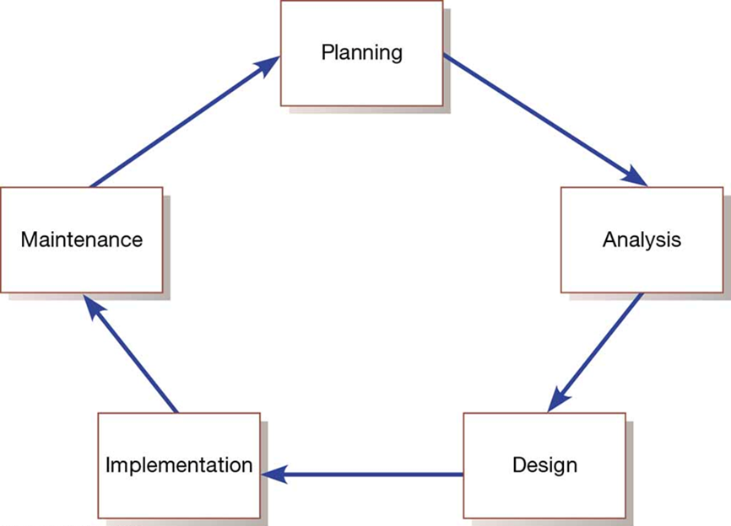
Figure 3: Systems Development Life Cycle

Slide 10
Phases of the S D L C (1 of 3)
Planning
Need for a new or enhanced system is identified
Needs are identified, analyzed, prioritized, and arranged
Determine the scope of the proposed system
Baseline project plan is developed
Analysis
System requirements are studied from user input and structured
Requires careful study of current systems, manual and computerized, that might be replaced or be enhanced
Output is description of the alternate solution recommend by the analysis team

Slide 11
Phases of the S D L C (2 of 3)
Design
The analyst converts the alternate solution into logical and physical specifications
Logical Design
The design process part that is independent of any specific hardware or software platform
Physical Design
The logical specifications of the system from logical design are transformed into technology-specific details from which all programming/system construction can be accomplished
Choices of language, database, and platform are many times already decided by the organization or client

Slide 12
Phases of the S D L C (3 of 3)
Implementation
Occurs when the information system is coded, tested, installed, and supported in the organization
New systems become part of the daily activities of the organization
Maintenance
The phase in which an information system is systematically repaired and improved
Organization’s needs may change over time requiring changes to the system based on user’s needs

Slide 13
Products of SDLC Phases
Phase | Products, Outputs, or Deliverables
Planning | Priorities for system and projects; an architecture for data, networks, and selection hardware, and information systems management are the result of associated systems Detailed steps, or work plan, for project Specification of system scope and planning and high-level system requirements or features Assignment of team members and other resources System justification or business case
Analysis | Description of current system and where problems or opportunities exist, with a general recommendation on how to fix, enhance, or replace current system Explanation of alternative systems and justification for chosen alternative
Design | Functional, detailed specifications of system elements (data, processes, inputs, and outputs) Technical, detailed specifications of all system elements (programs, files, network, system software, etc.) Acquisition plan for new technology
Implementation | Code, documentation, training procedures, and support capabilities
Maintenance | New versions or releases of software with associated updates to documentation, training, and support

Slide 14
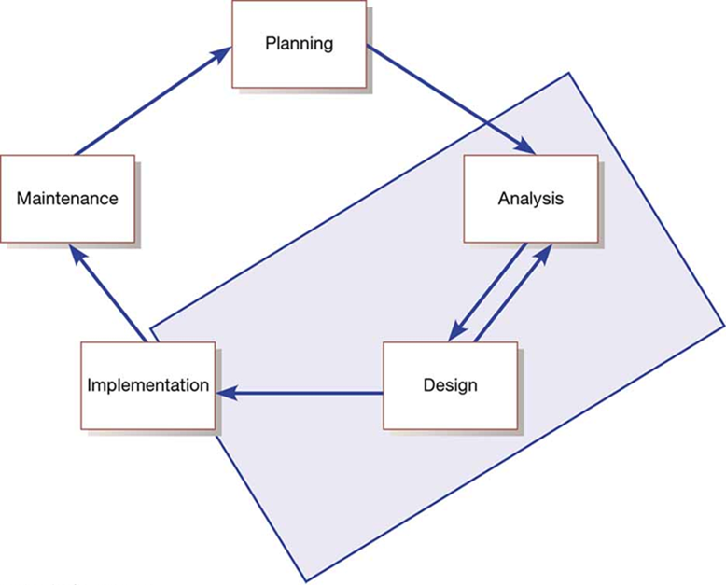
Heart of Systems Development
Current practice combines analysis, design, and implementation into a single process
Figure 1-7: Heart of Systems Development

Slide 15
The System Development Life Cycle (SDLC)
There are two general approaches to the SDLC
Predictive Approach
Waterfall model
Assumes the project can be planned and that the information system can be developed according to the plan
Requirements are well understood and/or low technical risk
Adaptive Approach to the SDLC
Iterative model
Assumes the project must be more flexible and adapt to changing needs as the project progresses
Requirements and needs are uncertain and/or high technical risk

Slide 16
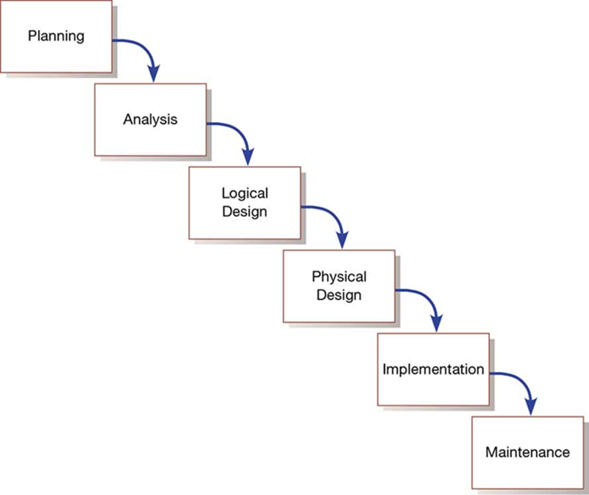
The S D L C Traditional Waterfall Problems
Once one phase ends another begins, going downhill until complete
Makes it difficult to go back
Results in great expense to make changes
Role of system users or customers narrowly defined
Focused on deadlines
Figure 1-8: Traditional Waterfall S D L C

Slide 17
Agile Methodologies
Agile methodologies share three key principles:
A focus on adaptive rather than predictive methodologies
A focus on people rather than roles
A focus on self-adaptive processes

Slide 18
Table 1-2: The Agile Manifesto (1 of 3)
The agile methodologies group argues that software development methodologies adapted from engineering generally do not fit with real-world software development
The Manifesto for Agile Software Development (Table 1-2)
Seventeen anarchists agree
We are uncovering better ways of developing software by doing it and helping others do it. Through this work we have come to value:
Individuals and interactions over processes and tools
Working software over comprehensive documentation
Customer collaboration over contract negotiation
Responding to change over following a plan

Slide 19
Table 1-2: The Agile Manifesto (2 of 3)
That is, while we value the items on the right, we value the items on the left more. We follow the following principles: (12 Agile Principle)
The highest priority is to satisfy the customer through early and continuous delivery of valuable software.
Welcome changing requirements, even late in development. Agile processes harness change for the customer’s competitive advantage.
Deliver working software frequently, from a couple of weeks to a couple of months, with a preference to the shorter timescale.
Businesspeople and developers work together daily throughout the project.
Build projects around motivated individuals. Give them the environment and support they need and trust them to get the job done.
The most efficient and effective method of conveying information to and within a development team is face-to-face conversation.
Working software is the primary measure of progress.

Slide 20
Table 1-2: The Agile Manifesto (3 of 3)
Continuous attention to technical excellence and good design enhances agility.
Agile processes promote sustainable development. The sponsors, developers, and users should be able to maintain a constant pace indefinitely.
Simplicity—the art of maximizing the amount of work not done—is essential.
The best architectures, requirements, and designs emerge from self-organizing teams.
At regular intervals, the team reflects on how to become more effective, then tunes and adjusts its behaviour accordingly.
--Kent Beck, Mike Beedle, Are van Bennekum, Alistair Cockburn, Ward Cunningham, Martin Fowler, James Grenning, Jim Highsmith, Andrew Hunt, Ron Jefferies, Jon Kern, Brian Marick, Robert C. Martin, Steve Mellor, Ken Schwaber, Jeff Sutherland, Dave Thomas (www.AgileAlliance.org)

Slide 21
Agile Methodologies—Not for Every Project
Agile methodologies are not for everyone
Fowler recommends an agile process if your project involves
unpredictable or dynamic requirements
responsible and motivated developers
customers who understand the process and will get involved

Slide 22
Table 1-3: Five Critical Factors that Distinguish Agile and Traditional Approaches to System Development
Factor | Agile Methods | Traditional Methods
Size | Well matched to small products and teams Reliance on tacit knowledge limits scalability | Methods evolved to handle large products and teams Hard to tailor down to small products
Criticality | Untested on safety-critical products Potential difficulties with simple design and lack of documentation | Methods evolved to handle highly critical products Hard to tailor down to products that are not critical.
Dynamism | Simple design and continuous refactoring are excellent for highly dynamic environments but a source of potentially expensive rework for highly stable environments | Detailed plans and Big Design Up Front, excellent for highly stable environment but a source of expensive rework for highly dynamic environments
Personnel | Requires continuous presence of a critical mass of scarce experts Risky to use non-agile people | Needs a critical mass of scarce experts during project definition but can work with fewer later in the project, unless the environment is highly dynamic
Culture | Thrives in a culture where people feel comfortable and empowered by having many degrees of freedom (thriving on chaos) | Thrives in a culture where people feel comfortable and empowered by having their roles defined by clear practices and procedures (thriving on order)

Slide 23
Agile in Practice
Three primary factors critical for success
Delivery strategy: Continuous delivery of working software in short time scales
Following agile software engineering practices
Team capability: Agile principle of building projects around motivated individuals
Agile development offers managers and programmers more choice in their efforts to produce good systems that come in on time and under budget

Slide 24
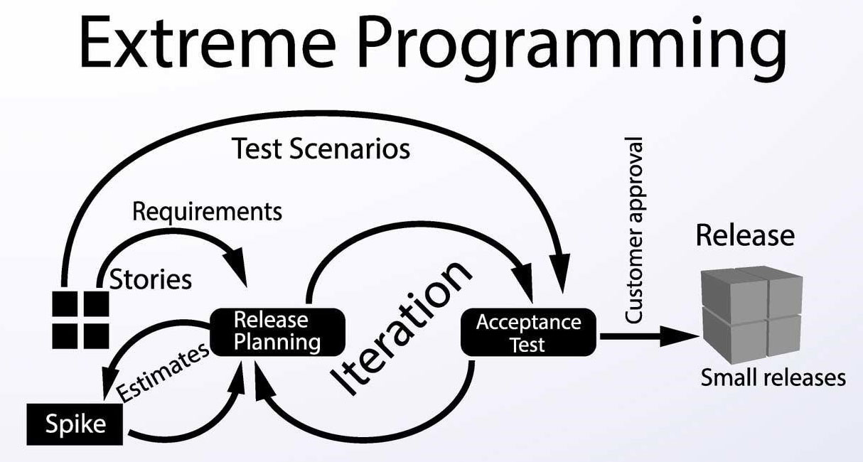
Figure 8: eXtreme Programming

Slide 25
eXtreme Programming (1 of 2)
Short, incremental development cycles
Focus on automated tests written by programmers
Emphasis on two-person programming teams
Customers to monitor the development process
Relevant parts of eXtreme Programming that relate to design specifications are
How planning, analysis, design, and construction are all fused into a single phase of activity
Its unique way of capturing and presenting system requirement and design specifications

Slide 26
eXtreme Programming (2 of 2)
Coding and testing are related parts of the same process
Advantages include
Increased communications among developers
Higher levels of productivity
Higher quality code
Reinforcement of other practices in eXtreme Programming
Include code-and-test discipline

Slide 27
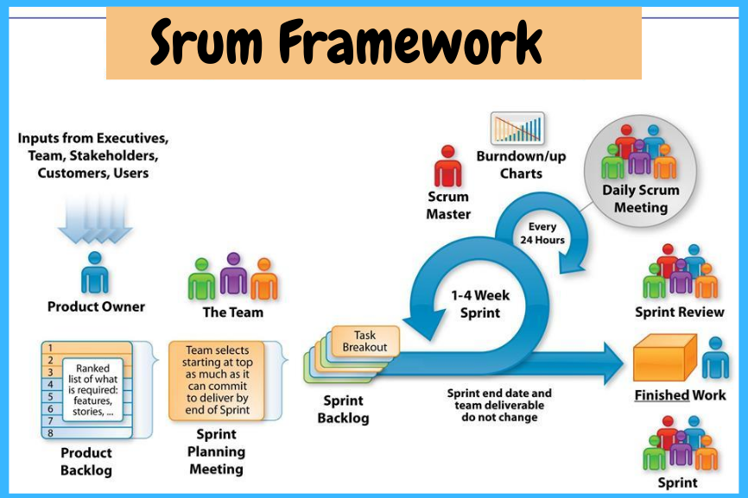
Figure 9: Scrum

Slide 28
Scrum (1 of 3)
Originated in 1995 by Sutherland and Schwaber
Most popular methodology for agile (58%)
Scrum framework includes
Scrum teams with associated roles, events, artifacts, and rules
Each team consists of three roles
Product owner
Development team
Scrum master

Slide 29
Scrum (2 of 3)
Scrum designed for speed and multiple functional product releases
Primary unit is the Sprint (runs two weeks to a month)
Starts with an eight-hour planning meeting
What needs to be delivered by the end of the sprint
How will the team accomplish that work
Daily Standup: A 15-minute meeting held to evaluate progress made within the past 24 hours and what needs to be done

Slide 30
Scrum (3 of 3)
At the end of the sprint, two additional meetings
The Sprint Review: (4 hours) focusing on the product, what has been accomplished, and what needs to be done
The Sprint Retrospective: (3 hours) focusing on team performance and how it can improve
Three primary artifacts in the Scrum process
Product Backlog: Listing of potential requirements
Sprint Backlog: Listing of only items to be addressed in a particular sprint
Increment: Represents the sum of all the Product Backlog items completed during a sprint.

Slide 31
Object-Oriented Analysis and Design (O O A D)
Based on objects rather than data or processes
Combines data and processes (called methods) into single entities call objects
Object: A structure that encapsulates attributes and methods that operate on those attributes
Inheritance: Hierarchical arrangement of classes enabling subclasses to inherit properties of superclasses
Object Class: Logical grouping of objects that have the same attributes and behaviors

Slide 32
Relational Unified Process (R U P)
Relational Unified Process (R U P) is an object-oriented systems development methodology
Based on an iterative, incremental approach to systems development
R U Ps four phases (each can be further divided)
Inception
Elaboration
Construction
Transition

Slide 33
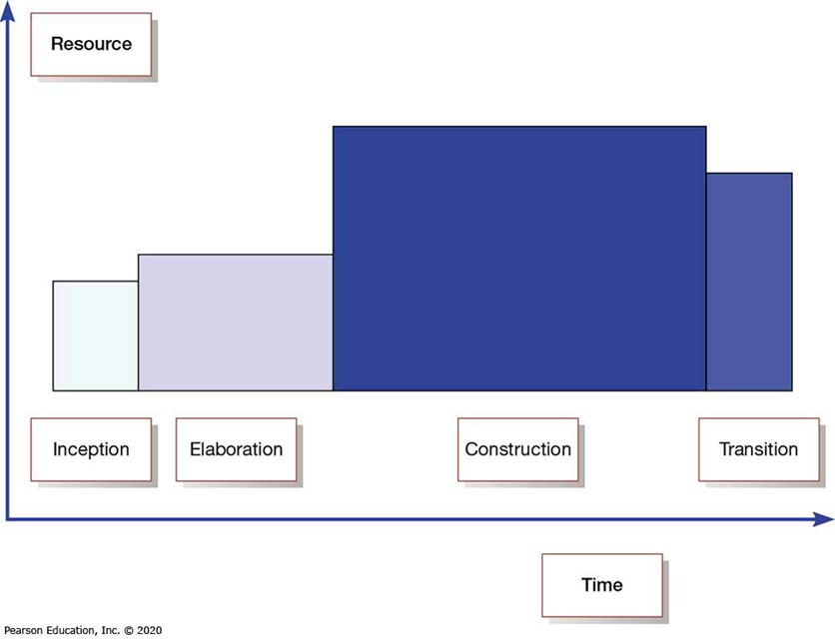
Figure 1-9: Phases of O O A D-Based Development

Slide 34
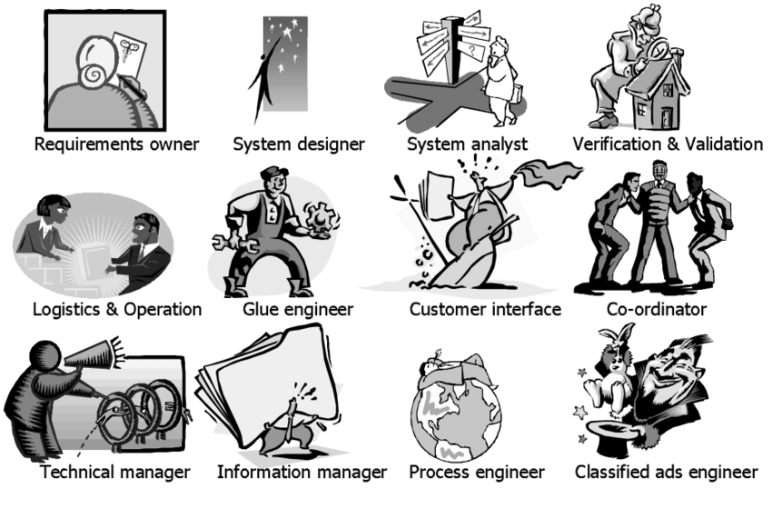
Roles of an Information System Engineer
….not a job title, but a role that people play:

Slide 35
Summary
Define Information Systems Engineering
Describe the information systems development life cycle (SDLC)
Describe the agile methodologies, eXtreme Programming, Scrum and RUP
Describe the roles of an information system engineer

